Slide 1
Bellabeat
Case Study
The final capstone project for the Google Data Analytics Certificate.

Slide 2

About the company
Bellabeat is a high-tech manufacturer of health-focused products for women. Some of its products are:
Bellabeat app
Leaf: Bellabeat’s classic wellness tracker can be worn as a bracelet, necklace, or clip.
Time: This wellness watch combines the timeless look of a classic timepiece with smart technology to track user activity, sleep, and stress.
Spring: This is a water bottle that tracks daily water intake using smart technology to ensure that you are appropriately hydrated throughout the day.
Bellabeat membership:

Slide 3

Project Objective
The aim is to unlock new growth opportunities for the company by focusing on one of Bellabeat’s products and analyzing smart device data to gain insights into how consumers are using their devices.

Slide 4
Identify trends and relationships
It is necessary to consider the sample size and selection when interpreting the data. The data is based on a sample of 33 individuals, which may introduce bias into the analysis. Additionally, there are limitations to the analysis due to a lack of information about how the sample was obtained.
7638
2304
21min
6h31min
Average number of steps at day
The average number of calories burned
The average amount of time spent in intense physical activity
The average amount of sleep time

Slide 5
According to the World Health Organization (WHO), it is recommended that adults engage in at least 150 minutes of moderate physical activity or 75 minutes of vigorous physical activity per week. This is equivalent to an average of 10,000 steps per day. According to estimations, a person can be considered sedentary when they burn around 1600-2000 calories per day, while a person who exercises regularly can burn between 3000-3500 calories per day.

Slide 6
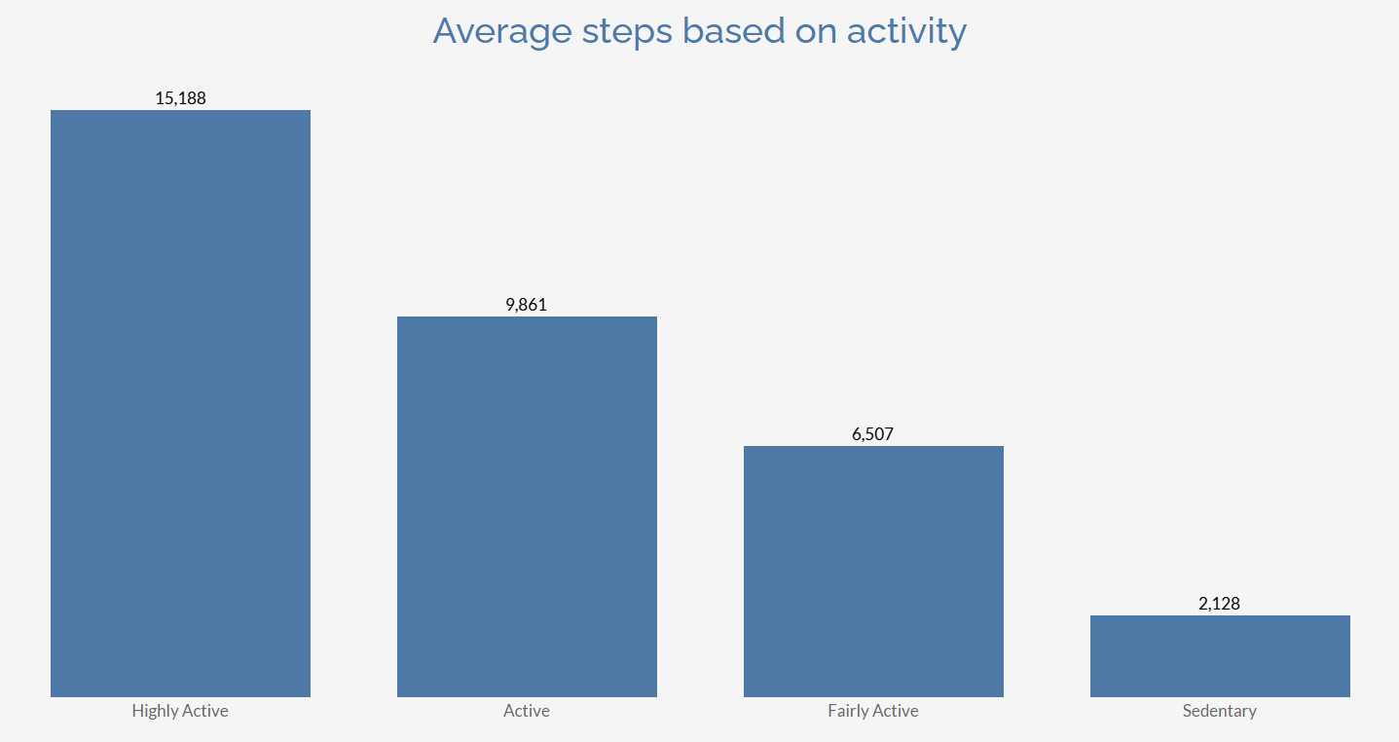
The graph shows us the average number of steps for each type of activity

Slide 7
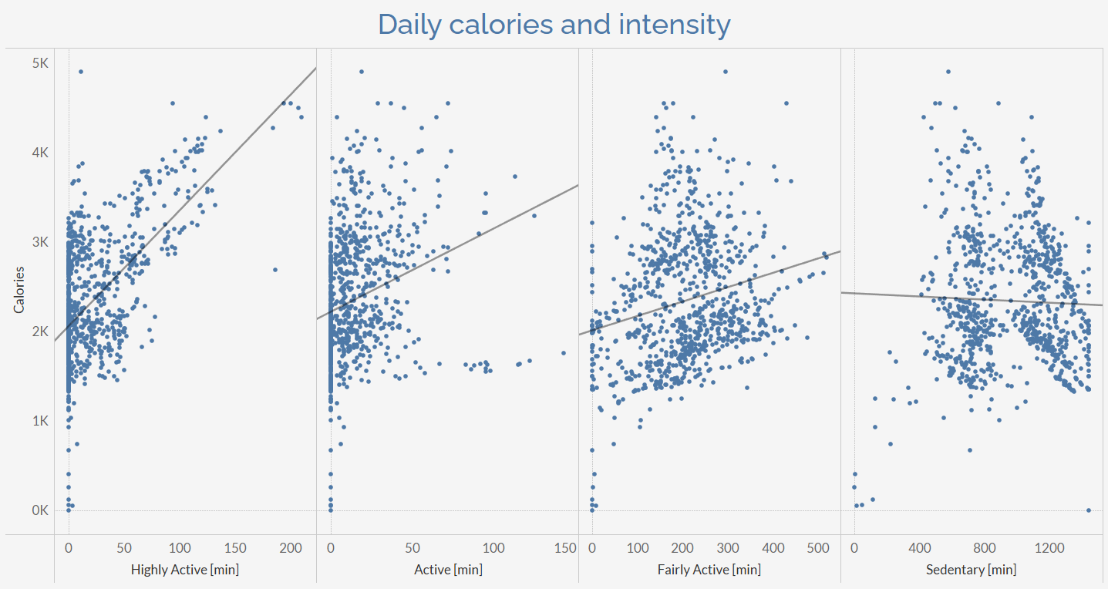
There is a positive correlation between the type of activity and the calories burned, meaning that the more highly active you are, the more calories you burn, and vice versa. According to the data set results, 20 minutes of highly intense activity burns the same amount of calories as 8 hours of sedentary activity.

Slide 8
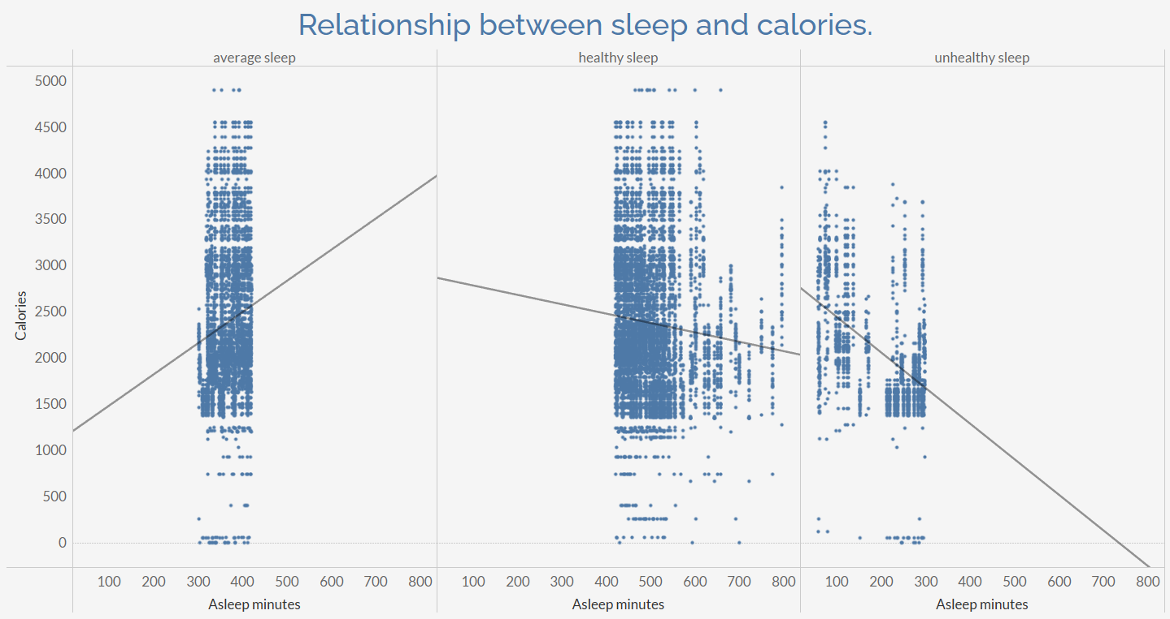
This visualization shows us a positive correlation between calories and sleep, which means that if you sleep for more than 8 hours or less than 5 hours, you burn fewer calories, while if you sleep between 5 and 8 hours, you tend to burn more calories. This means that sleep quality has a positive impact on your physical activity and, therefore, on your health.

Slide 9
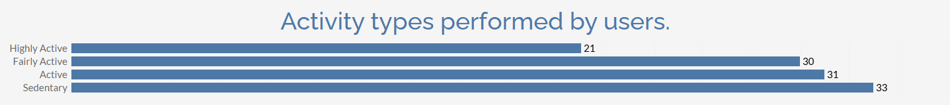
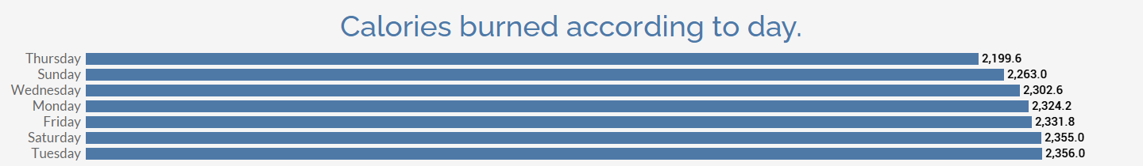

Slide 10
Conclusion.
Most of the people within the dataset who use Bellabeat products lead sedentary lives, but during the data collection period, it is also shown that they engage in activities to take care of their health, although this is not a daily habit for everyone. This causes their physical activity based on the number of steps and calories burned to be only slightly above that of a completely sedentary person. Therefore, it is necessary to add highly active physical activity for at least 30 minutes to achieve the goal proposed by the WHO of 3000 daily calories burned.

Slide 11
Recommendations based on your analysis.
01 | Weekly contests that allow users to create a more active community and become more familiar with Bellabeat.
02 | Contests based on physical activity and getting enough sleep.
03 | The Bellabeat app product can offer recognition to its users for meeting goals by rewarding them with discounts on their other products for their usage.
04 | Recommending a home workout routine to help achieve fitness goals.
05 | Recommending activities to improve sleep quality.
06 | Recommending activities to eat healthily.
07 | Newsletter providing information on how much to sleep, how much to exercise, and other tips.
06 | Simplifying the information entry process for users.

Slide 12



Thanks.
Contact info:

